Slide 1

Accident Analysis Alliance
AI Boot Camp Project 1
- Fredy Aguirre - Brian Hansen-Turton - Alan Hunt - Ketan Parekh
Notes:
We represent the Accident Analysis Alliance.

Slide 2

Our Mission
Revolutionizing Road Safety with
AI-Driven Data Analysis
Notes:
Auto accidents are a common experience, and their impact can be significant, even if the physical damage is minor. Leveraging AI and data analytics, this project aims to revolutionize road safety by identifying hidden patterns in crash data to inform targeted interventions and reduce accidents.“

Slide 3


About OUR Team
Motivation
Personal Experience
Shared Mission
Commitment
Notes:
The genesis of the Accident Investigation Alliance arrived out of our fundamental human desire to prevent unnecessary suffering at the hand of preventable accidents. Each of our team members has personally experienced the consequences of an automobile accident, leading to ongoing challenges. This shared experience has fueled our mission to prevent others from enduring similar suffering.

Slide 4

Accidents are Preventable
Prevention
Beyond the cause
Understanding underlying factors
Empowering municipalities
Focused strategies
Notes:
Accidents are not just unfortunate events; they are often preventable. Our unique analytical approach goes beyond simply identifying the cause. By understanding the underlying factors that contribute to preventable accidents, we empower municipalities to formulate focused strategies for mitigating their frequency.

Slide 5
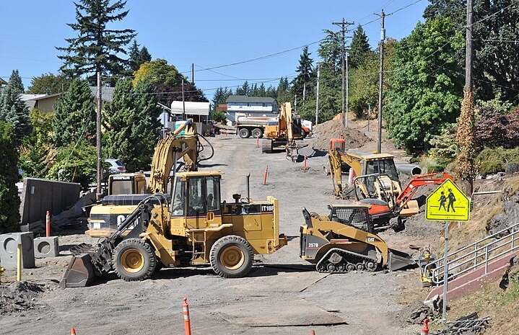
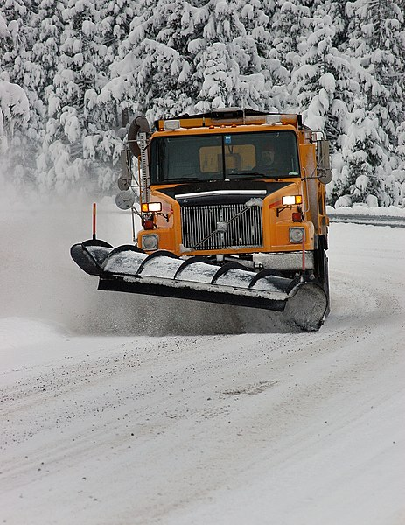
Data-Driven Solutions for Safer Roads
Identify root causes
Targeted strategies
Safer communities
Cost savings
Notes:
This project seeks to revolutionize road safety by leveraging cutting-edge AI and data analytics. By meticulously analyzing crash data, we aim to uncover hidden patterns and identify the root causes of vehicle accidents. Our comprehensive analysis will delve into factors including road conditions, weather, and time intervals to generate actionable insights. Ultimately, these findings will inform targeted interventions, such as improved infrastructure, deployment of new signage, and the re-focusing of equipment for weather events, resulting in substantial human and financial cost savings for all stakeholders.

Slide 6
Analysis
Time based histograms
Effect of weather conditions
Predictions
Geolocation Analysis

Slide 7
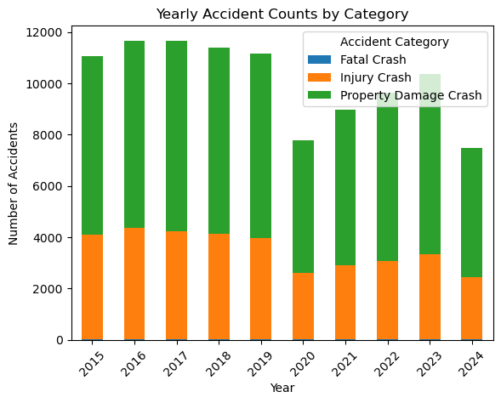
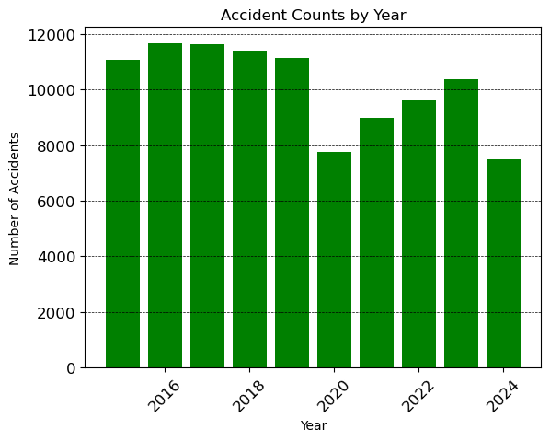
Time based histograms
Key Findings:
Sudden drop in 2020
Recovery after Return to Office policy
Situation not much changed

Slide 8
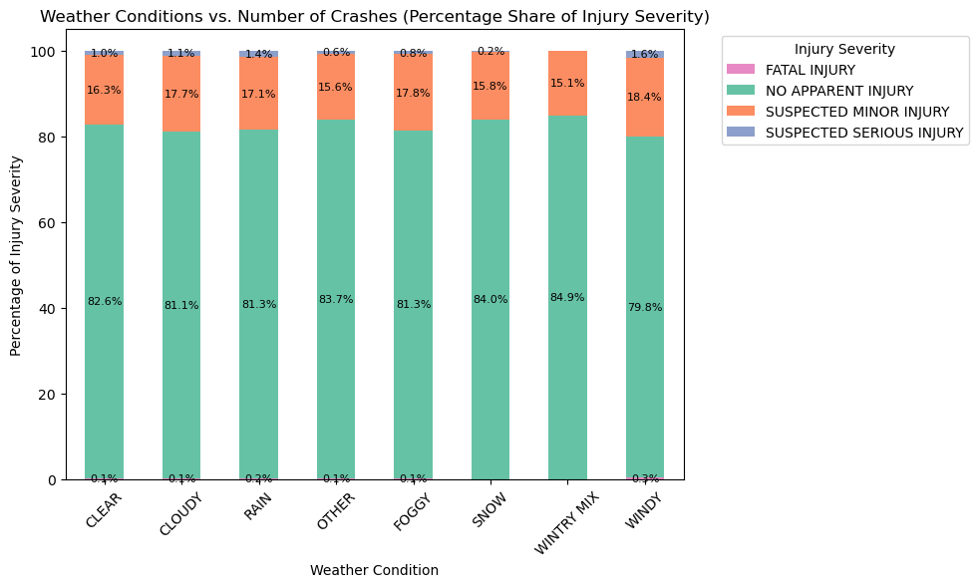
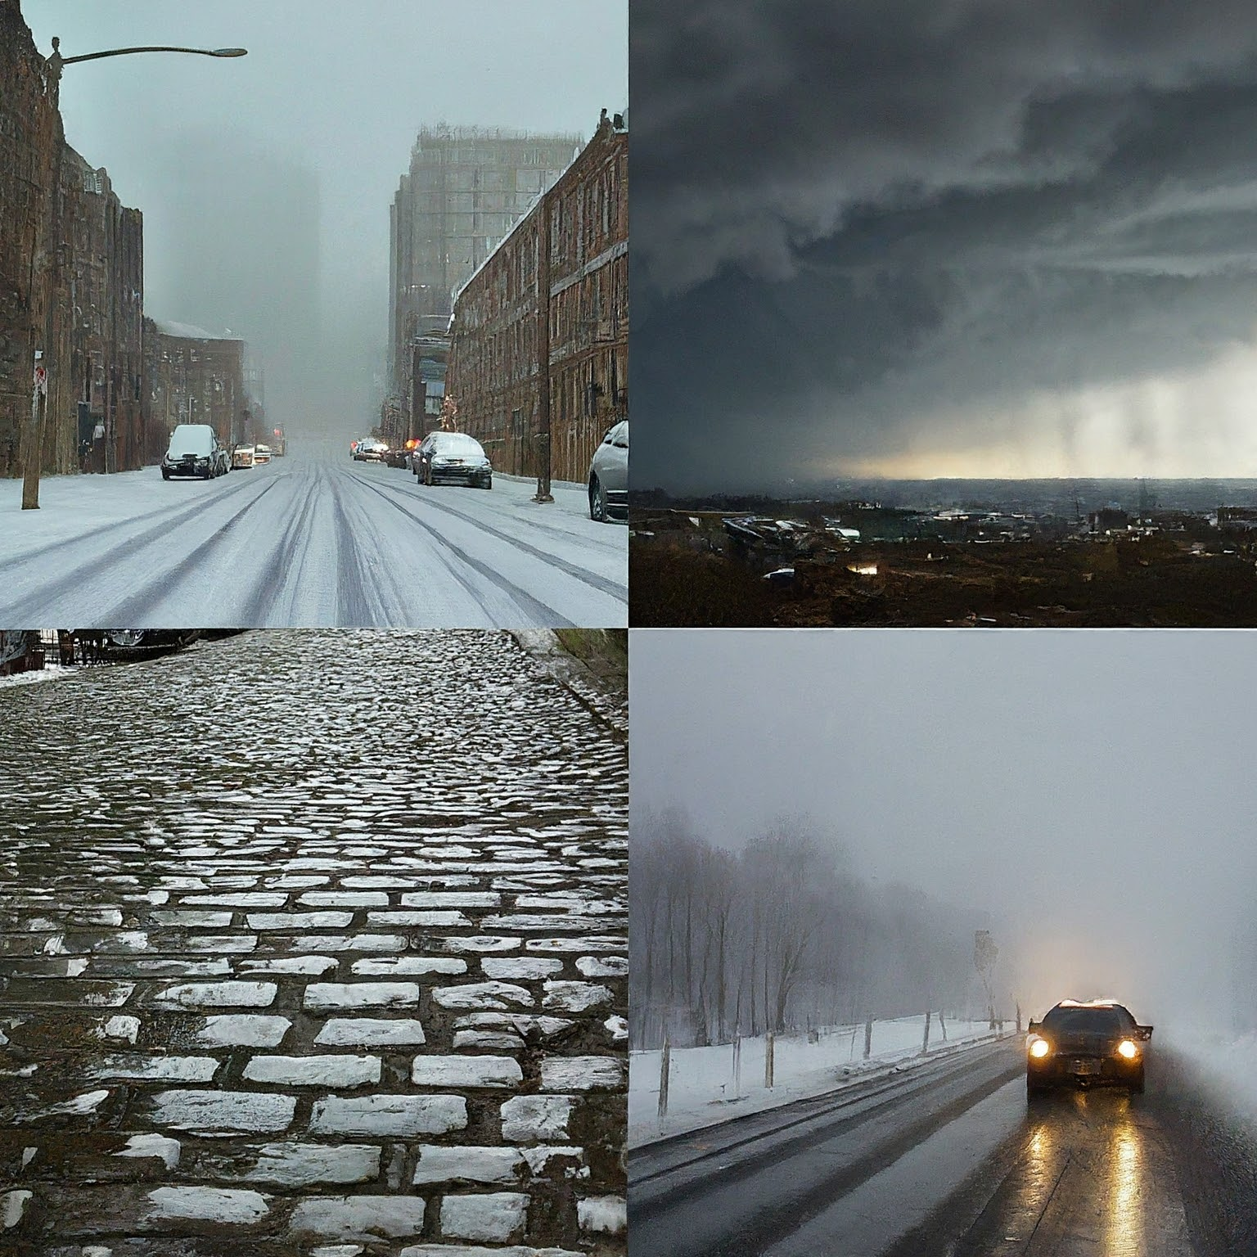
Weather conditions
Key Findings:
Almost equal distribution
Severity of injuries seem weather agnostic
Minimal effect of weather

Slide 9
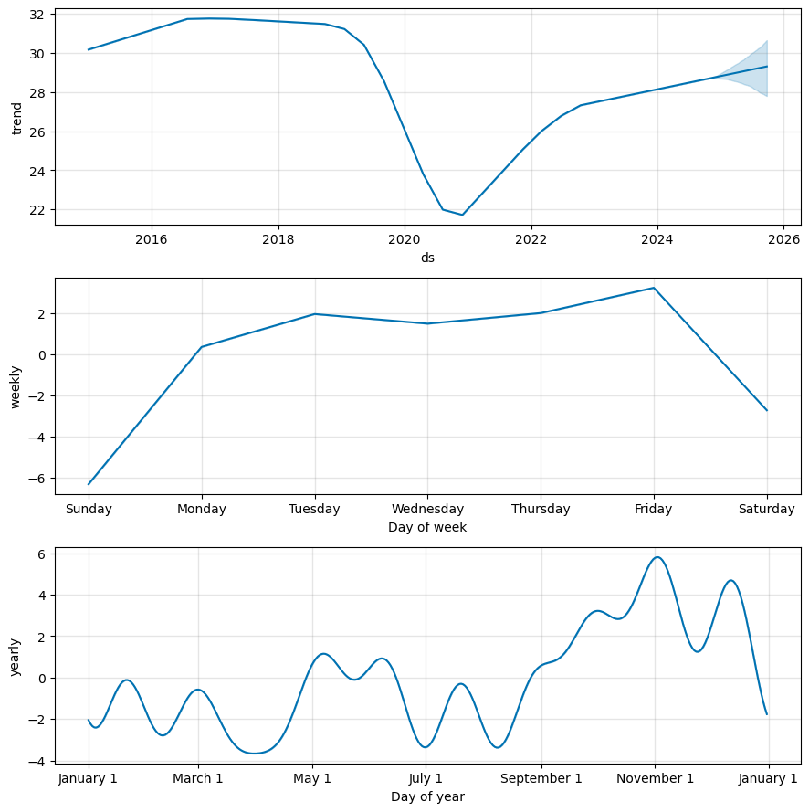
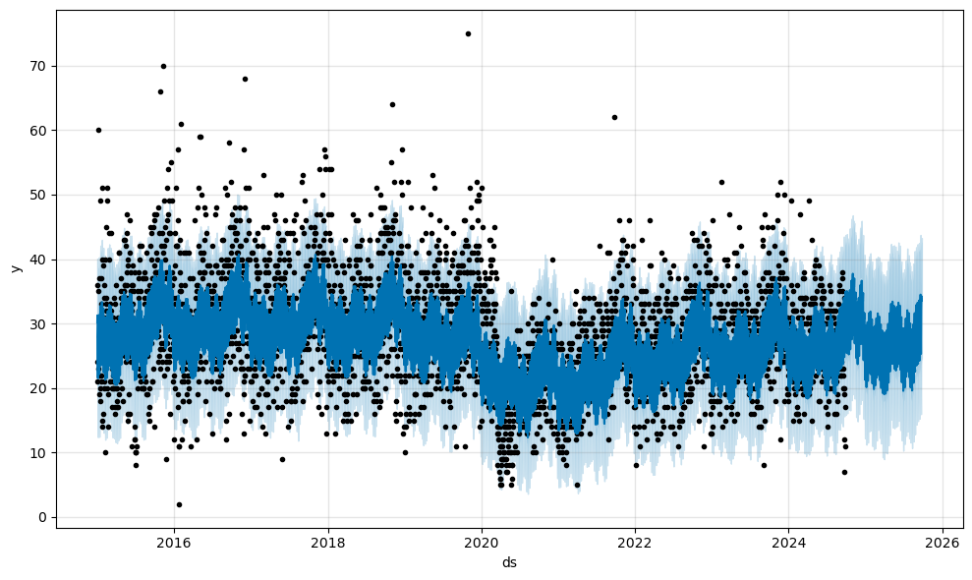
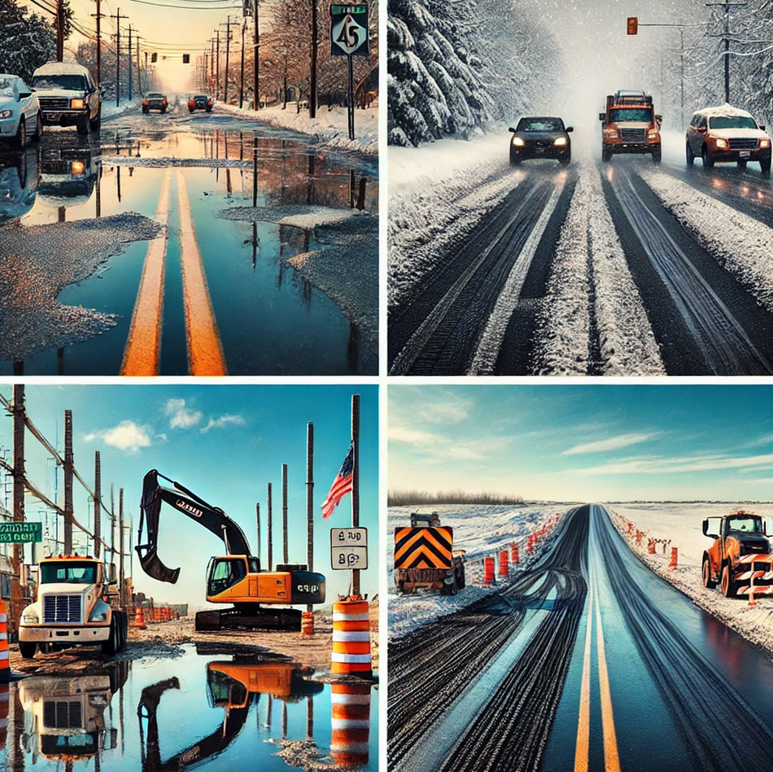
Predictions
Key Findings:
Drop in 2020 and Recovery
November seem to have peak number
Weekdays & Weekends

Slide 10
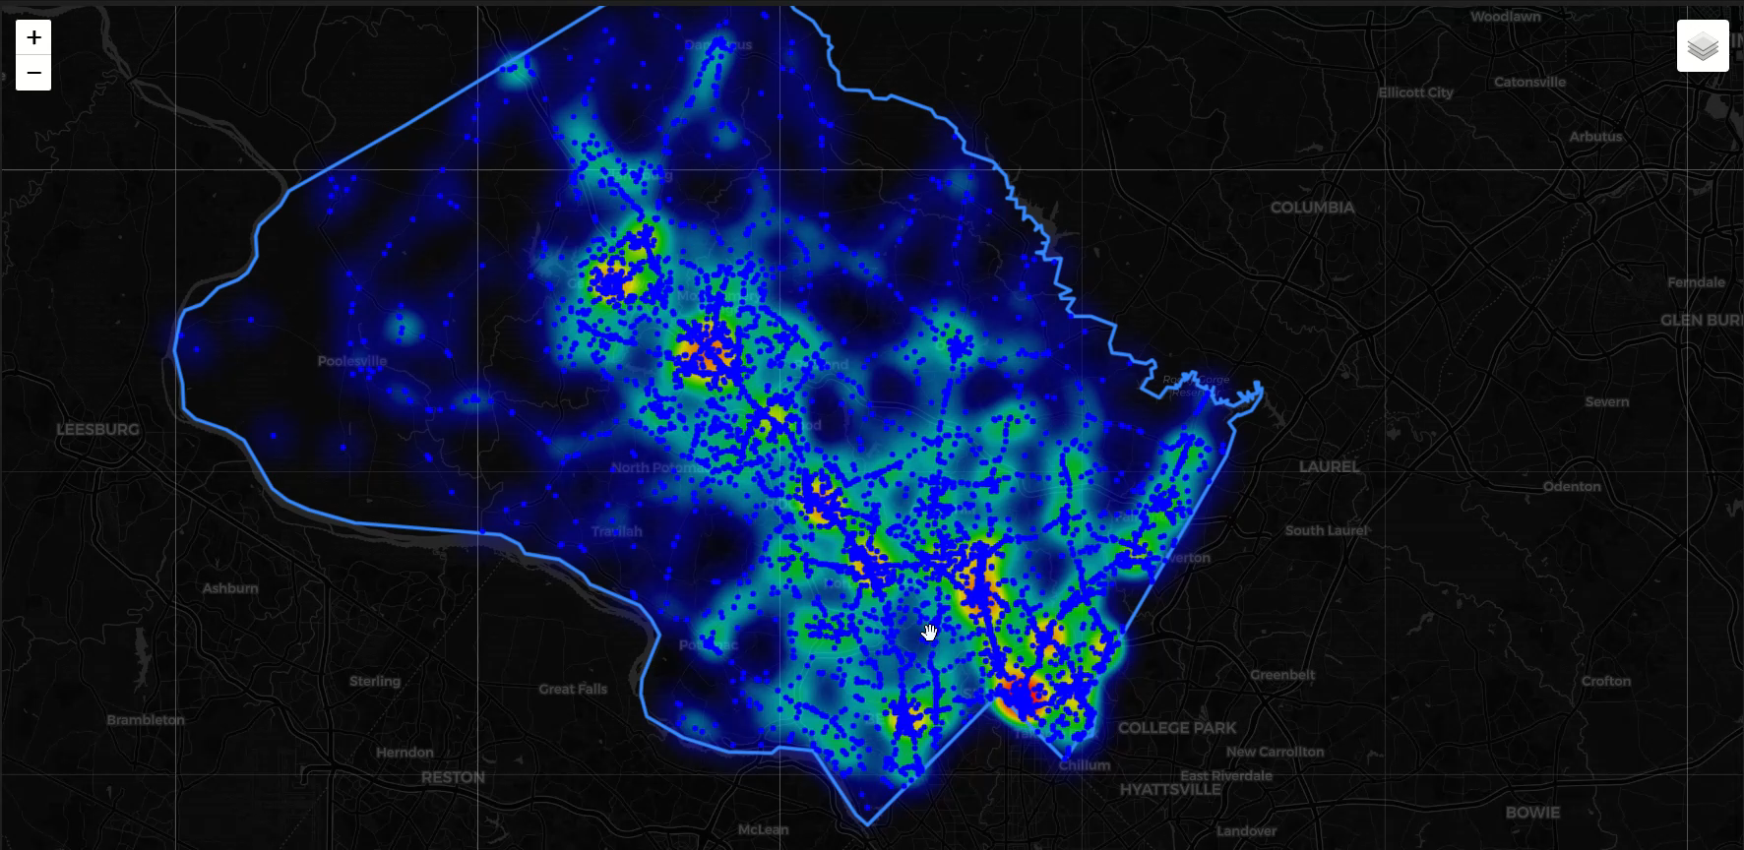
Heat Map for 2024 Car Crashes
2024 car crashes
Intersection hotspots
Map functionality

Slide 11
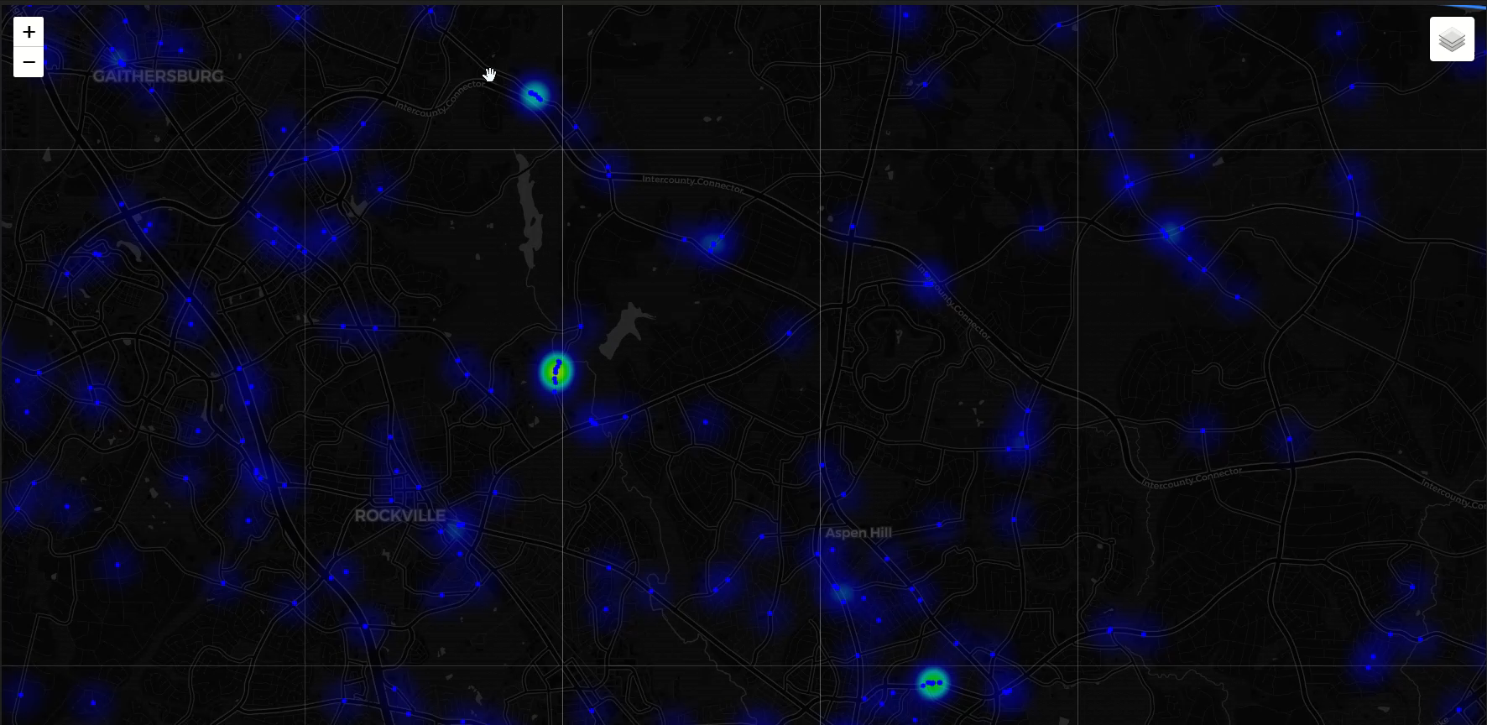
Heat Map for Icy Road Car Crashes
2015-2024 time interval
Icy road car crashes
Identifying road segments

Slide 12
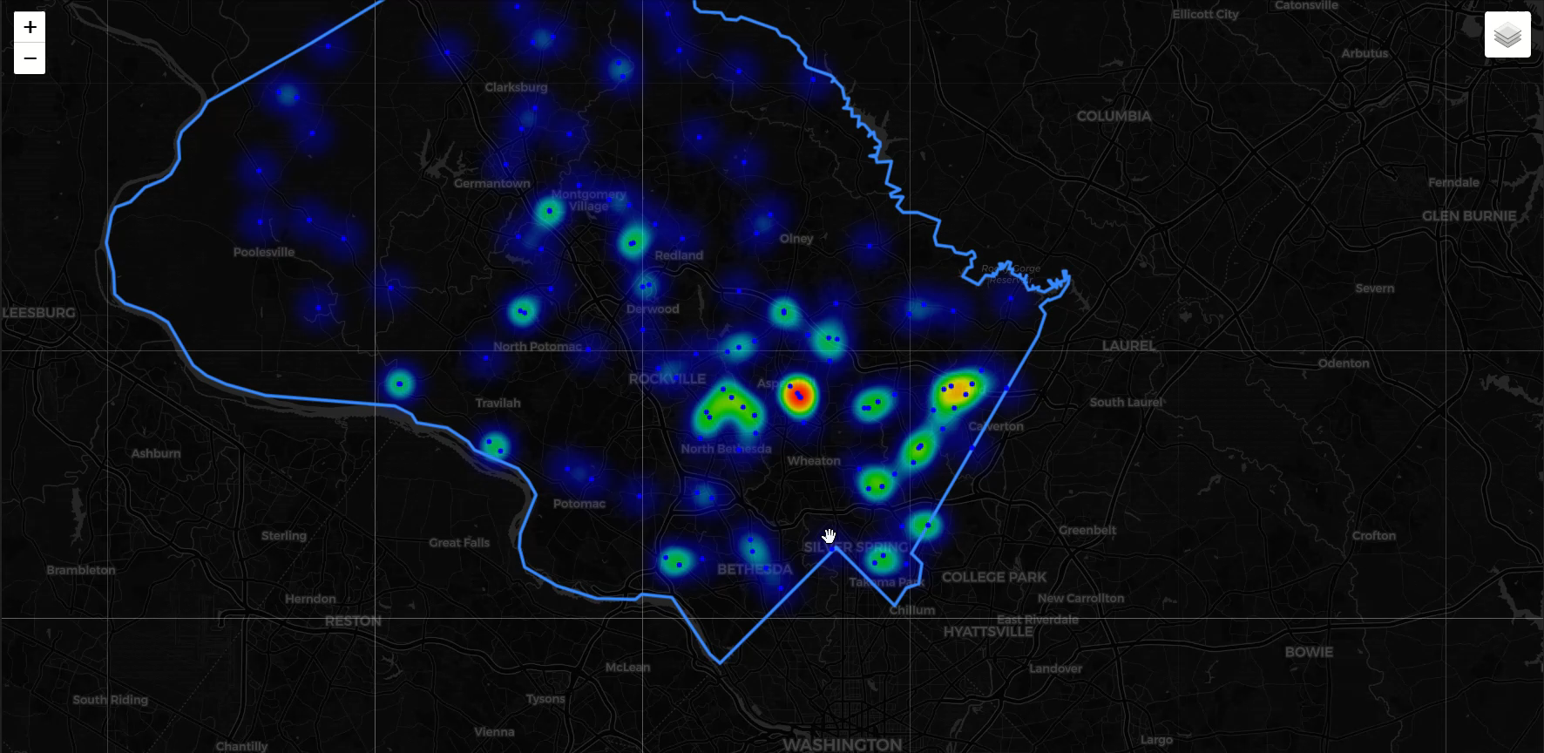
Heat Map for Fatal Car Crashes
2015-2024 time interval
Fatal road car crashes
Identifying road segments

Slide 13

Too many data sets
Difficult to align the data
Limit scope
Found ideal data
Notes:
We encountered difficulties in correlating NOAA weather data with accident data from the National Highway Traffic Safety Administration due to the complexity and scale of the datasets.
Our initial scope, focused on the entire state, proved too broad to yield meaningful insights.
Through additional research, we identified Montgomery County traffic data, which contained more relevant attributes and provided a clearer framework for analysis.
This discovery allowed us to narrow our focus and effectively address the challenges, ultimately enabling us to move forward with the project.

Slide 14
CONCLUSION & NEXT STEPS
Data Gaps and Future Action:
Need additional data on traffic density
Census data would provide more insight
More granular, localized weather data
Notes:
Throughout our analysis of accident data from Montgomery County, we gained valuable insights into the factors that contribute to accidents, including weather conditions, time of day, and location. However, we identified gaps in the data that limit our ability to make more precise conclusions.
Specifically, we recognize the need for additional data on the number of vehicles on the road during the time of the accidents.
Understanding traffic density will allow us to better understand the factors that contribute to accidents.
Additionally, incorporating census data, such as population density and demographic information, would provide crucial context for understanding how different areas and populations are affected by accidents.
While weather data was analyzed, the current dataset lacks the granularity needed to understand the conditions at the exact time of the accidents. More accurate, localized weather data will enhance our ability to link specific conditions, such as precipitation or fog, to accident occurrences.
Going forward, acquiring additional data points, including census data, will enable more comprehensive analysis, leading to more informed recommendations for improving road safety. This expanded dataset will allow us to create targeted interventions to reduce the frequency and severity of accidents.
s.

Slide 15
THANK YOU
Montgomery County Maryland
Suzanna Ayash
Jimmy Tran
Notes:
We would like to express our gratitude to Montgomery County, Maryland, for the data used in this analysis. We would also like to express our appreciation to Suzanna and Jim for their invaluable guidance throughout this process.

Slide 16

Questions ?
Github profileS
Fredy - Padawan2024
Brian - Brian-Hansen-Turton
Alan - hknala
Ketan - 36KP
https://github.com/Brian-Hansen-Turton/module-9-project.git
Notes:
Thank you all for your time and attention throughout this presentation.
We would now like to open the floor to any questions you may have.

